Slide 1
Maya DevTV
Maya programming introduction
Autodesk Developer Network
Chengxi Li
Developer technical consultant
Notes:
Hi, this is Chengxi Li from ADN.
I am going to introduce you the Maya API programming in this video.

Slide 2
Session Agenda
Why programming in Maya
Overview of Maya Languages
Maya API Overview
Setup your environment
Available Resources
Notes:
In this session, we are going to introduce you the Maya API programming.
Start with the purpose of programming Maya and then make a quick overview about the programming language of Maya and Maya API.
We also provided environment setup instruction separately and you can check it out later.
At last, we will show you some resources for developing Maya plugins.

Slide 3
Why programming in Maya?
Notes:
Let’s begin with the purpose of API programming in Maya.

Slide 4
Why programming in Maya
Create project-specific functionality, for specific workflows and requirements.
Automate repetitive, time-consuming tasks and extend features
Uses popular, easy-to-use Python scripting language
The C++ and Python API to create custom tools and features that plug directly into Maya
Notes:
Maya is widely used in the game and movie industry for producing digital contents.
Most studios are having their own pipeline. Programming with Maya can make Maya better integrated in your working pipeline and let Maya do some tasks automatically. This can be easily done with Maya Python scripting.
For more advance usage, you can write your own nodes, deformers, renders etc for Maya in C++ including .net Wrappers, Python. For example, in our advanced topics, we will show you how to use Oculus Rift for live previewing in the Viewport 2.

Slide 5
Overview of Maya Languages
Notes:
There are several language we provided for Maya programing

Slide 6
Programming In Maya Possibilities
Maya Embedded Language (MEL)
API
C++
Python
.Net
Notes:
Maya has its own language, MEL. It’s mainly for the commands inside Maya.
For more customization, we provide 3 language for you. They are C++, python and .net C++ Wrapper.

Slide 7
MEL Scripting
MEL (Maya Embedded Language) is a scripting language at the heart of Maya.
Everything you can do using Maya’s graphical interface can be automated and extended using MEL.
Maya’s user interface is created using MEL, and MEL provides an easy way to extend the functionality of Maya.
Familiarity with MEL can deepen your understanding of and expertise with Maya.
Notes:
Let’s begin with the MEL first .
MEL is the abbreviation of the Maya Embedded Language. Which is the core language of Maya usage.
All of the UI interaction in Maya can be translated into a MEL command. You can use maya with the MEL itself to complete the job.
MEL is also used for customizing the user interface. For example, you can use AETemplate which based on MEL to customize the attribute editor for your custom nodes. You can find them in the scripts folder in your Maya installation.
Learning MEL well can improve your productivity of Maya itself. However, if you want a more customized Maya, you’ll need to program with MAYA API

Slide 8
Maya C++ API
The Maya API increases Maya’s power, customizing and extending Maya in many ways that you never thought possible.
It provides functionality for querying and changing the Maya model along with the ability to add new Maya objects to the Maya model.
You can use the Maya API to implement two types of code resources: plug-ins which extends the functionality of Maya, and standalones such as console applications which can access and manipulate a Maya model.
Notes:
We provide several languages for developing Maya plugins.
First, we provide C++ API.
The API extends Maya in Maya in many ways. For example, it can query and modify the model and add new objects. Like meshes, positions.
You can also customize the viewport and many other features of Maya. In our advanced topics, there will be a session about how to project the viewport to the oculus rift for live preview.
In this series of lesson, we are going to develop write plugin for Maya in C++.

Slide 9
Advantages of C++ API
Can be 10+ faster than Python
Compiled, no source code discloser
More classes and function exposed
More detailed manipulation of lower level core
More devkit samples and resources
Notes:
Using C++ as your Maya development language could have following advantages:
First of all, It is faster and more powerful than python and .net wrappers.
Second, Unlike python script and .net platform, source code is harder to get for C++ which is essential to commercial products.
Since we provide the C++ APIs from the beginning, you can access to the full Maya API with C++, and you can access to some of the lower core level of Maya.
At last, there are more samples in our devkit for C++.

Slide 10
Python Scripting & API
Python is a powerful and popular object-oriented scripting language.
Maya Python API which allows developers to write Maya plug-ins and stand-alone applications without having to learn C++.
This integration of Python in Maya empowers production facilities to better integrate Autodesk Maya into your production pipeline.
Notes:
And we also provide python scripting.
Python is slower than C++, but it is much easier to learn.
In Maya 2016, we provide more APIs for Python. There is only few missing APIs or methods for the Python port. It is easier for prototyping your plugin and a better choice for creating pipeline tools for Maya.

Slide 11
Advantages of Scripting
Easier learning curve
Easy setup
Platform Independent
Tons of free modules (Python)
Easily move between API and Scripting capabilities in Maya all with in the same plug-in or script (Python)
Notes:
The first advantage of programming with Python is easy to learn and it is very powerful.
Unlike C++, it needs almost no setup for the python environment and it is platform independent.
Python has a very good community and you can get lots of free modules. Unlike C++, you can write both Mel script and Python scripting without any third party tools.
Let’s get a sneak peak into the Maya Api.

Slide 12
Maya API Overview

Slide 13
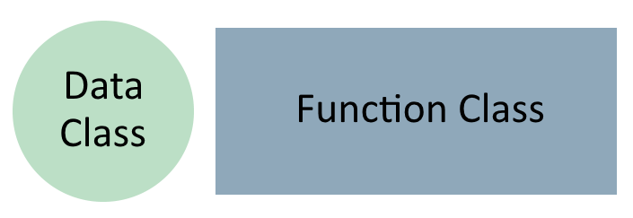
Class Categories
Proxy
Starting with MPx, owned by Maya
MPxCommand, MPxNode, etc…
Function sets
Starting with MFn, owned by you
MFnDependencyNode, MFnMesh, etc…
MFn::Type MFnBase::type()
MFnMesh(myMeshObject) or MFnMesh::setObject(myMeshObject)
Notes:
APIs in Maya are having prefixes before them and can be classified.
Generally, there are four kinds of APIs in Maya.
First comes the proxy class. The Maya API uses proxy objects to create new types of Maya objects. Proxies are objects that you create but Maya owns. You can create commands with MPxCommand and nodes with MPxNode. Objects created by proxy classes like other Maya native objects are owned by Maya.
Then we have function sets, which operate on objects. Like the MFnDependencyNode allows the creation and manipulation of dependency graph node and MFnMesh can modify the mesh info of a shape.
You can use MFn::Type enumeration to get the corresponding item types. Objects and function sets are used together all the time, you can bind an object to a function set with the constructor or using setObject. Using setObject may have better performance by avoiding creating and destroying function sets each time you need one.

Slide 14
Class Categories
Iterator
Starting with MIt
MItSelectionList, MItMeshVertex, etc…
Wrapper Classes
Starting with M only
MPoint, MVector, etc…
Notes:
Next we have iterator classes, starting with MIt. It works like other c++ iterators, using for looping over elements of the same type.
Like MItSelectionList for iterating through a SelectionList, MItMeshVertex for iterating vertices in a mesh.
At last is wrapper class, it starts with M only. Usually they are some simple objects like Mpoints, Mvector etcetera. But there are several important function classes also starts with M only, like Mglobal, Mobject and so on. The most widely used is Mobject which is the fundamental data type that represents an object in Maya.

Slide 15
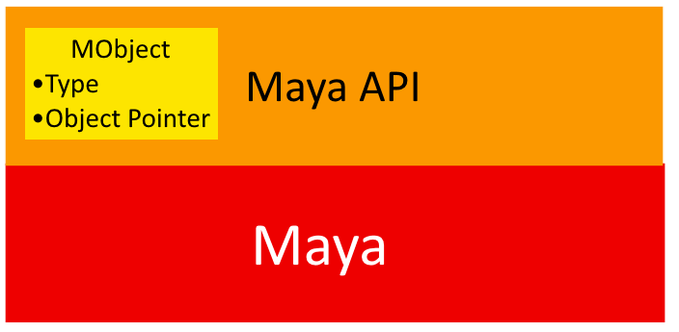
MObject
Object owned by Maya are accessed via a MObject
MObjects are handles to Maya internal objects, created and destroyed by Maya
Use function sets to operate on it
Use MFn::Type MObject::apiType() and MObject::hasFn(MFn::Type) to check api type.
Never keep a pointer to an MObject between "runs" of the plug-in, use MObjectHandle instead
Notes:
Objects owned by Maya are accessed via an Mobjects.They are handles to Maya internal objects which are created and destroyed by Maya.
You can use corresponding function set to operate on the Mobject.
Eash MObject has mainly two kinds of information: object type and pointer to the object. User can use apiType to get the type of an Object and hasFn to check whether a function set is usable for current object.
Notice that you should never keep a pointer to a Mobject in your plugin. Please use MObjectHandle instead.

Slide 16
MPxCommand Crash course
Notes:
Hi, this is Chengxi Li from Autodesk Developer Network.
In today’s lesson, we are going to learn to write a simple Maya Command and some of the Maya utility classes

Slide 17
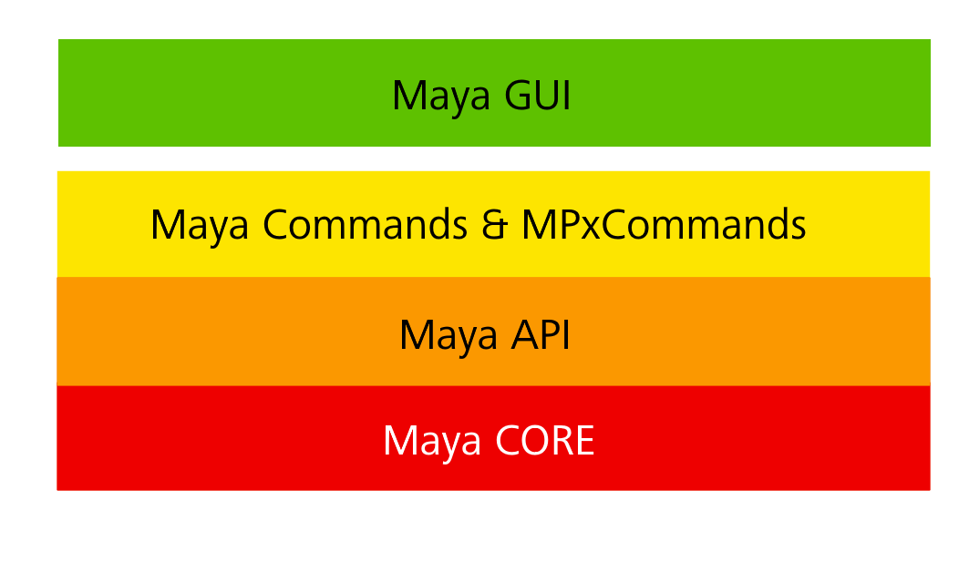
Why MPxCommand ?
Leveraging Maya API
Customize Maya API
Notes:
MPxCommand can be implemented as complementary of Maya commands, which allows user to access powerful Maya APIs.
You can implement your own Maya Command and use them in the scripts to complete more powerful job.

Slide 18
Basic Implementation
All Maya custom commands are derived from MPxCommand
Two necessary functions are needed to be implemented
creator()
doIt()
Notes:
All user custom commands are derived from MPxCommand class.
For the MPxCommand there are several things we need to take care of, like syntax, undo/redo. But in this session, we will begin with the fundamental parts.
The creator and doIt function.
In first part, we will base on the helloCmd sample in the DevKit.

Slide 19
Maya Devkit Sample: HelloCmd
Use a macro to implement a basic class
DeclareSimpleCommand( hello, PLUGIN_COMPANY, "4.5");
The macro has creator(), doIt(), constructor and destructor
Notes:
Hellocmd sample uses a macro to define the skeleton of a Maya command.
The sample code defines a hello class with basic constructor and destructor, creator, doIt. It also implements initialize and uninitialize methods.

Slide 20
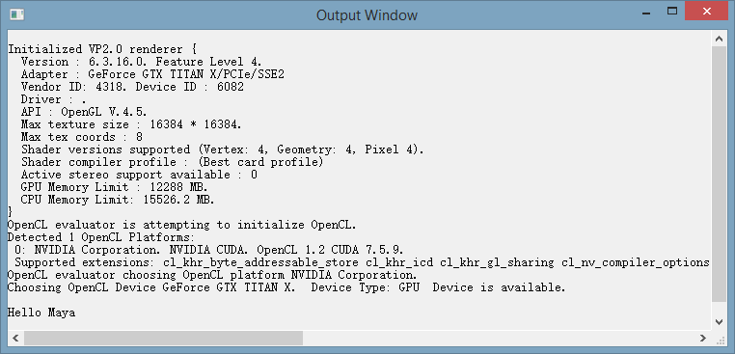
Maya Devkit Sample: HelloCmd
Execution
Result
Notes:
Load the sample with the Maya plugin manager and try to use the command in the MEL script like above.
You can find the hello output in the Maya’s output window.
How does it work? Let’s begin with the initialize.

Slide 21
Register your MPxCommand
Register your custom command
MStatus initializePlugin( MObject _obj ) {
MFnPlugin plugin( _obj, “Autodesk”, “4.5”);
MStatus stat;
stat = plugin.registerCommand( “hello”, hello::creator );
if ( !stat ) stat.perror("registerCommand");
return stat;
}
Unregister your MPxCommand
MStatus uninitializePlugin( MObject _obj ){
MFnPlugin plugin( _obj );
Mstatus stat;
stat = plugin.deregisterCommand( “hello” );
if ( !stat )
stat.perror("deregisterCommand");
return stat;
}
Notes:
Maya needs the plugin register before it can be loaded and unregister when it unloads.
The DeclareSimpleCommand marco provides the basic initialize and uninitialize functions. In the future, we may have some extra work during these processes. But right now, we only need the basic function.
During the register, we’ll need to provide the class’s creator for Maya to create the instance of the plugin.
First, we need to declare our plugin with the company name and version like the first line;
Then, we need to register our plugin to Maya. Since we are implementing a command , so we are going to use the registerCommand method.
During the uninitialize, we need to deregister the plugin like the register. First get the plugin, the call the unregister command.

Slide 22
creator() Function
Creates an instance of the command
Static function
Singleton
It can be simple as:
return new class();
Notes:
The creator function is a static function, and it should return an instance of the command.
It can be used for creating singleton instance. In this case, we just want to show you the basic of MPxCommand.
So it is simply return a new instance;

Slide 23
doIt() Function
Called whenever command is executed
HelloCmd:
MStatus hello::doIt( const MArgList& args ){
cout<<"Hello "<<args.asString(0).asChar()<<endl;
return MS::kSuccess;
}
It can accept arguments and perform user-defined operation
Notes:
The doIt Function is the main function of a custom command.
The main code should be inside this function.
In the sample, it will only return a hello string. It can accept arguments. Maya also provides a syntax explainer to help user create command with more sophisticated
arguments.

Slide 24
Interactive exercise - HelixTool

Slide 25
MPxToolCommand
Create interactive tools
Icon
Interactive in viewport
Sample: helixTool
source: github.com/iamsleepy/helixToolTutorial
Copy helixTool.xpm to the icons folder inside Maya
Execute helix.mel, helixValues.mel, helixProperties.mel in order
Notes:
MPxToolCommand is for creating interactive commands. Like drawing a sphere or helix in this case.
It could have an icon on the toolbar like other Maya tools and you can click or drag in the viewport like other tools.
The sample for this lesson is different from the one provided in Maya 2016 devkit, please download it from our github.
To execute it properly, please copy the helixTool.xpm which is the icon for the toolbar into the icons folder of Maya.
After loading the plugin, please execute helix.mel, helixValues.mel and helixProperties.mel in order to create the tool.
The first script will create a command context for the tool and create an icon in the custom shelf for the tool. The second and third ones will setup the properties and ui for the tool.

Slide 26
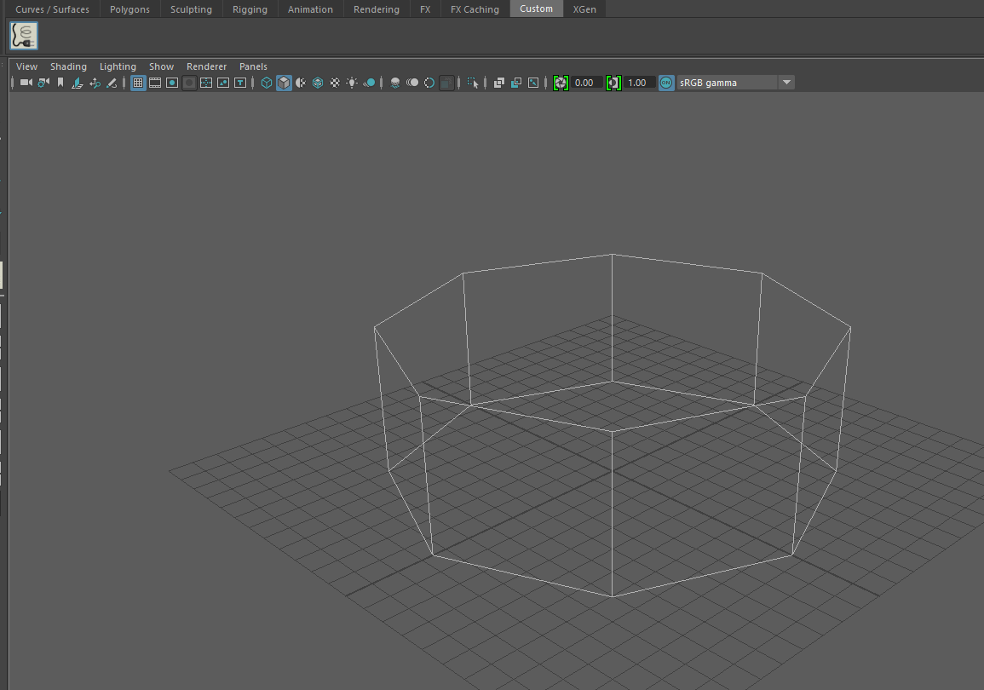
helixTool - Demo
Notes:
After executing these scripts, you can find the tool on the shelf. Activate it and drag in the viewport, you’ll find it is drawing cylinder as helix indicator. When you release the button, you will found a helix curve is created.

Slide 27
Undo/Redo

Slide 28
Maya command
Maya commands support an undo/redo framework
The undo/redo queue can be:
Turned off
Have a limited/infinite size
Defined in ‘Settings and Preferences’
Retains all of its parameters, operations and data.
Life time depends on the queue settings
Notes:
MPxCommand like other commands, it supports an undo/redo framework. It is using the undo/redo queue built in Maya.
This queue can be turned off and has a given size, it could be limited or infinite. It be set in the settings and preferences.
When a command is put into the undo/redo queue, it will retain all of its data, including parameters, operations. The command’s lifespan depends on the user’s setting.

Slide 29
Undo/Redo rules
A command that alters the scene must have undo/redo implemented
Undo must reverse the change as if it has never happened
Undo queue only exists in current Maya session
Notes:
There are general rules for the commands.
If a command alters the scene, including objects or other nodes, they must have undo/redo implemented in the command.
As the undo in other Maya commands, it must reverse the changes it had done as it has never happened.
Finally, the undo queue is not saved with the scene, one the file is closed, the undo queue is lost.

Slide 30
Undo/Redo Functions
isUndoable()
Override this method to return true/false to denote if this command supports undo/redo
undoIt()
Called by “undo” command
redoIt()
Called by “redo” command
Notes:
isUndoable() : used to specify whether or not the command is undoable. False by default. Overwrite to return True if you want Maya to undo the command
undoIt() : Override with the undo functionality to reverse the redoIt() functionality
redoIt() : This method should do the actual work (if available) of the command based on the internal class data only. Internal class data should be set in the doIt method. Called on command redo
doIt() : The doIt() method performs the actions of the command. In more complex commands, the doIt() method parses the argument list, the selection list, and whatever else may be necessary. It then uses this information to set data internal to the command before calling the redoIt() method, which does the bulk of the work. This avoids code duplication between the doIt() and redoIt() methods. Called on command execution

Slide 31
Syntax
Notes:
Let’s begin with syntax.

Slide 32
Command Arguments
Optional
Command Flags and Flag Arguments
Command Arguments
Multiple command flags and arguments but only one command arguments.
Notes:
The command arguments are optional, it include flags and flags’ arguments. Also, the could be one command argument for each command.

Slide 33
Syntax
Required classes
MSyntax
MArgDatabase
MArgParser
MArgList
MSyntax and MArgParser
Notes:
To make syntax work, you will need following classes.
The most important ones are MSyntax and MArgParser.

Slide 34
Syntax
Required classes
MSyntax
MArgDatabase
MArgParser
MArgList
MSyntax and MArgParser
Notes:
To make syntax work, you will need following classes.
The most important ones are MSyntax and MArgParser.

Slide 35
Interactive helixTool
Notes:
Let’s begin with syntax.

Slide 36
helixTool
MPxContext
Defines how tool looks like and works in Maya UI
Icon
Cursor
Mouse events
…
Call the command with context data after mouse events
MPxContextCommand
Contains MPxContext
Allow user to modify MPxContext parameter with UI
Notes:
To make the tool working interactively, you need create a tool context for at.
It will define the UI info and mouse events for the tool.

Slide 37
helixTool
Constructor
setTitleString
setCursor
setImage
toolOnSetup
setHelpString
Notes:
In the constructor of the context, developer should set the tool name via setTitleString, cursor with setCursor and icon with setImage.
Developers should also implement toolOnSetup and setup help string with setHelpString there.

Slide 38
helixTool
UI Interactive
doPress
doDrag
doRelease
doEnterRegion
Legacy
OpenGL
Viewport2
MUIDrawManager
Notes:
For the interactive, the context provides 4 different events, including press, drag, release and enterRegion.
For each event, it has two overrides. One for legacy viewport and another for Viewport 2.0.
In legacy viewport, developers are going to use opengl to draw the UI.
In the VP2, we can use the MUIDrawManager to draw UI, it supports both DirectX and OpenGL.

Slide 39
MUIDrawManager
Works in VP2
Can draw both DirectX and OpenGL
Provide basic drawing function
beginDrawable()
line, lineStrip, etc..
endDrawable()
Notes:
It only works in VP2 and draw both DX and GL.
It uses like GL functions. Begins with beginDrawable, then do some drawing with basic drawing functions like line, lineStrip, etc…
At last, call endDrawable to finished the drawing.
You can check the sample we provided for this session, it has both legacy viewport and VP2 implementation.
For more VP2 details, please refer to our VP2 session in the later.

Slide 40
Questions?

Slide 41
www.autodesk.com/adn
www.autodesk.com/developmaya
www.autodesk.com/maya
Autodesk, the Autodesk logo, AutoCAD, FBX, HumanIK, Maya, MotionBuilder, Mudbox, Revit, Softimage, and 3ds Max are registered trademarks or trademarks of Autodesk, Inc., and/or its subsidiaries and/or affiliates in the USA and/or other countries. All other brand names, product names, or trademarks belong to their respective holders. Autodesk reserves the right to alter product and services offerings, and specifications and pricing at any time without notice, and is not responsible for typographical or graphical errors that may appear in this document..
.

